Slide 1
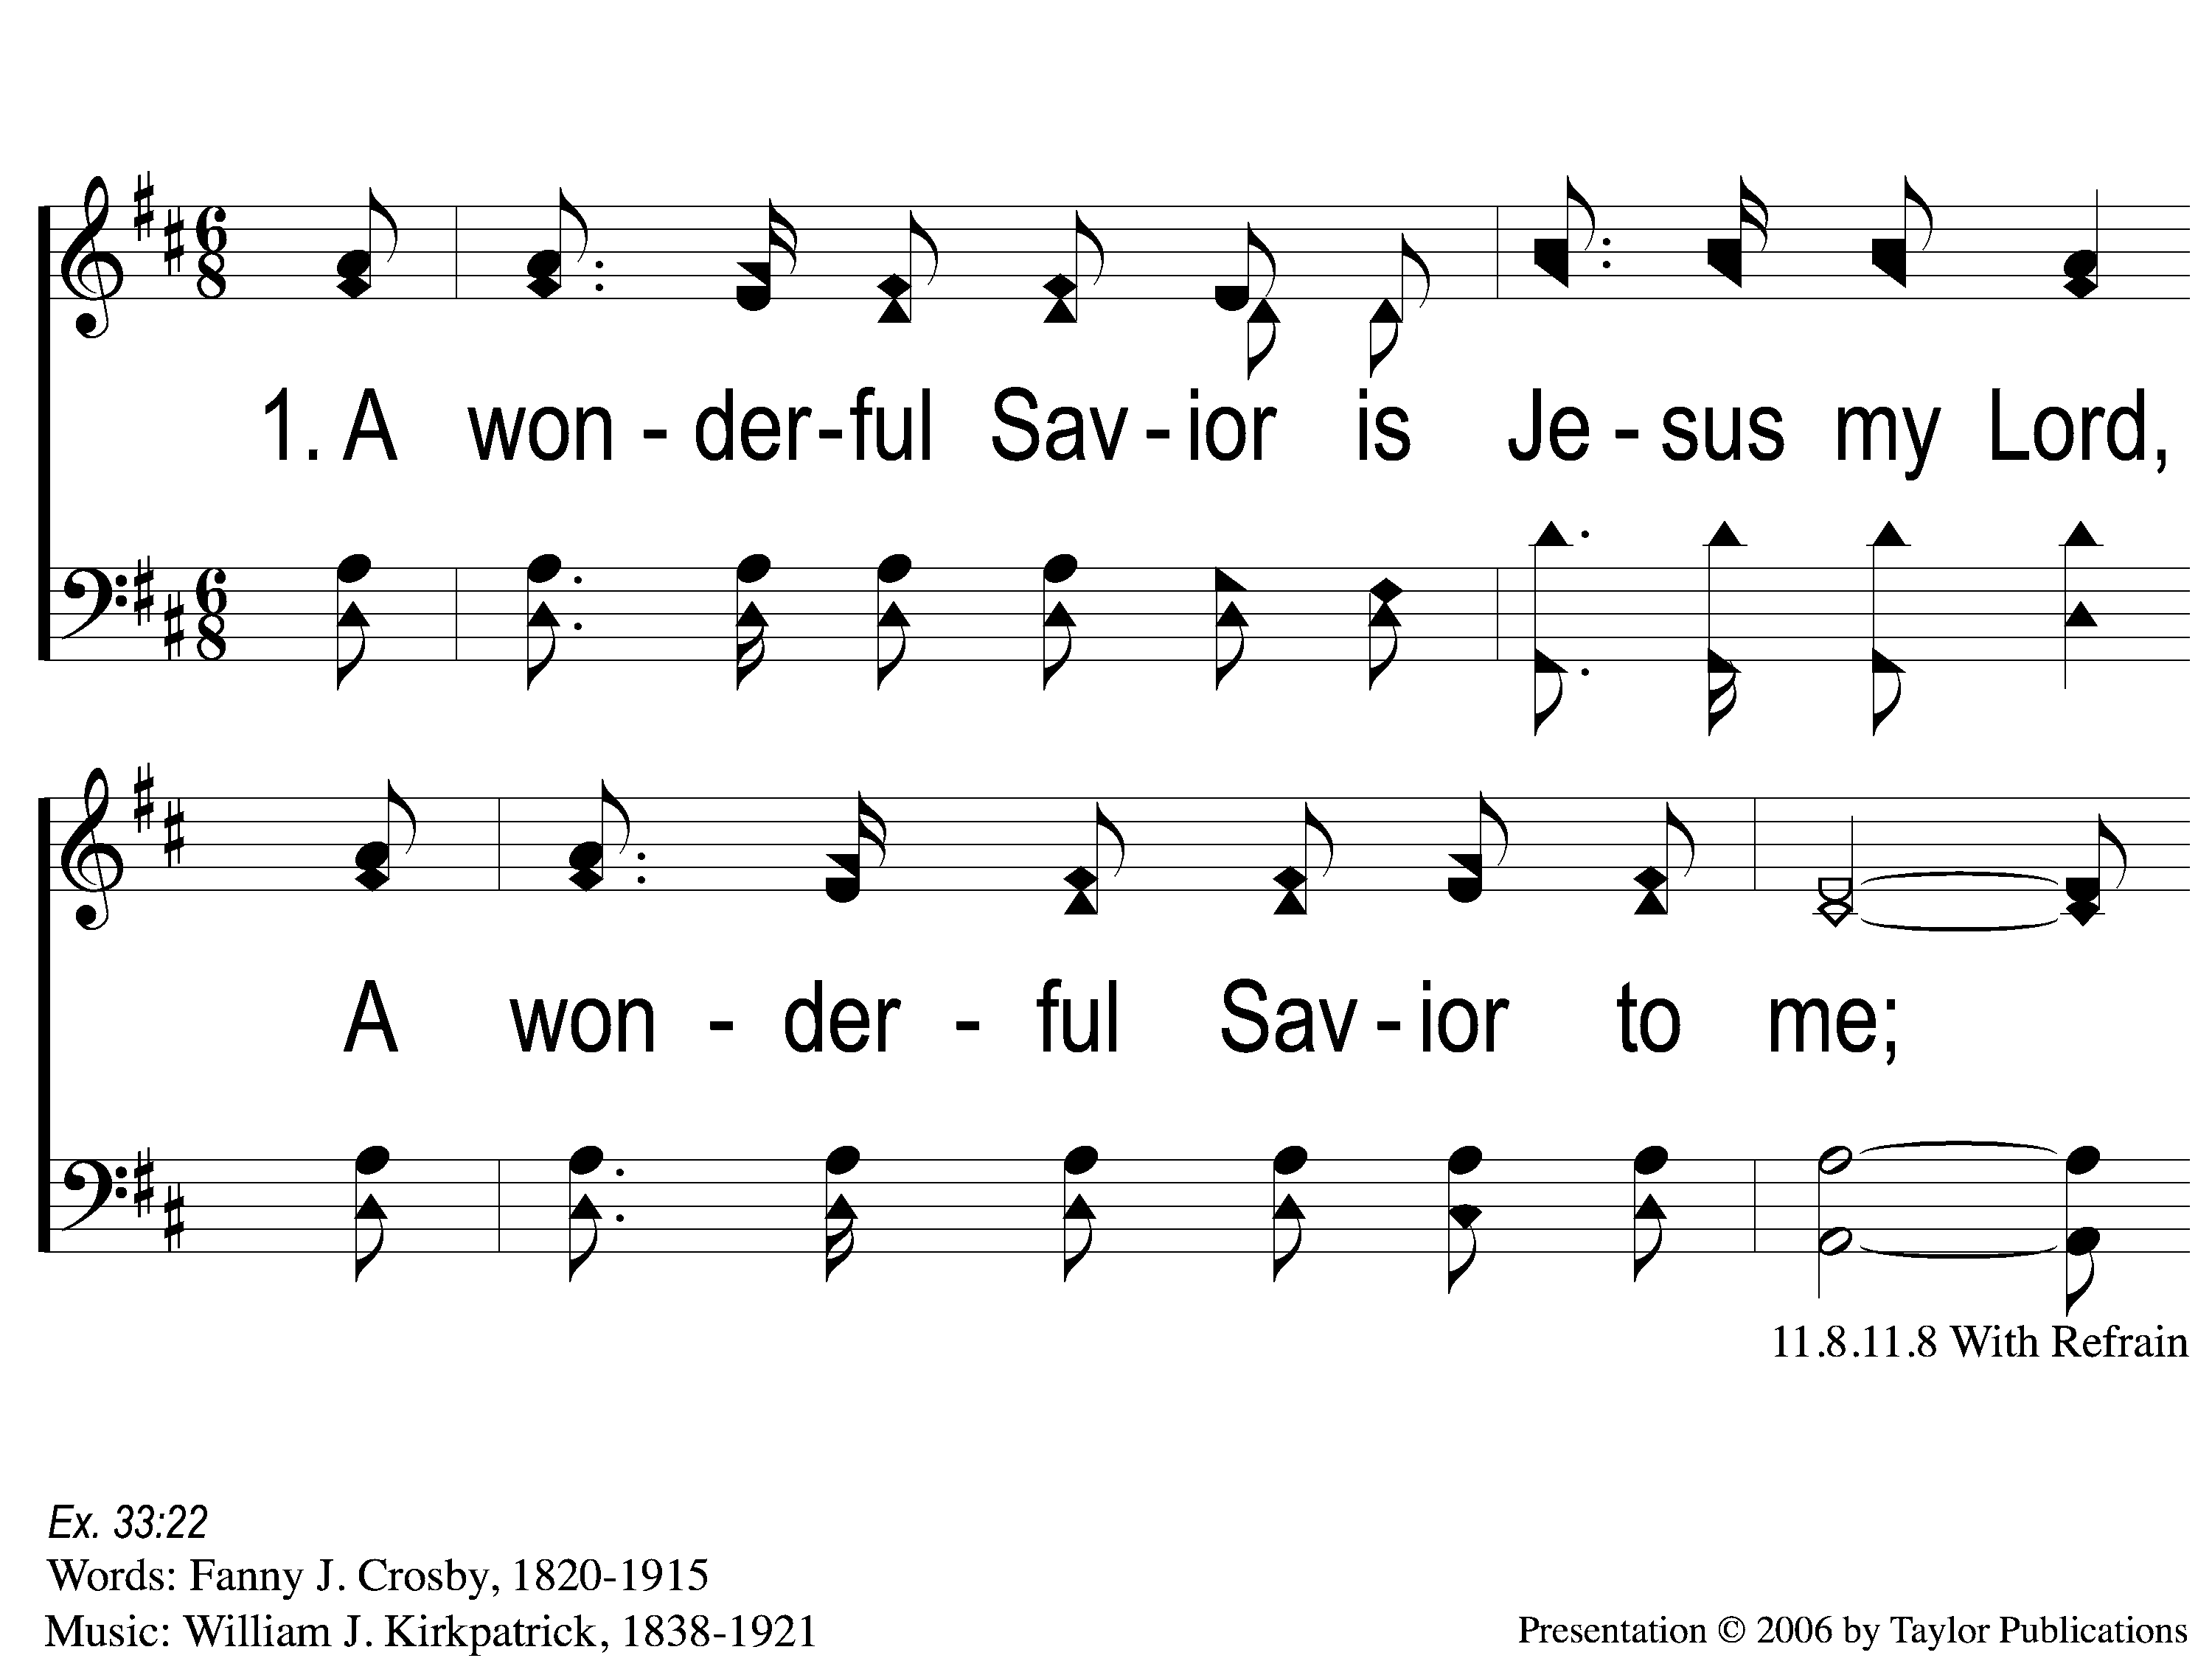
1-1 A Wonderful Savior(Crosby)
A Wonderful Savior
2

Slide 2
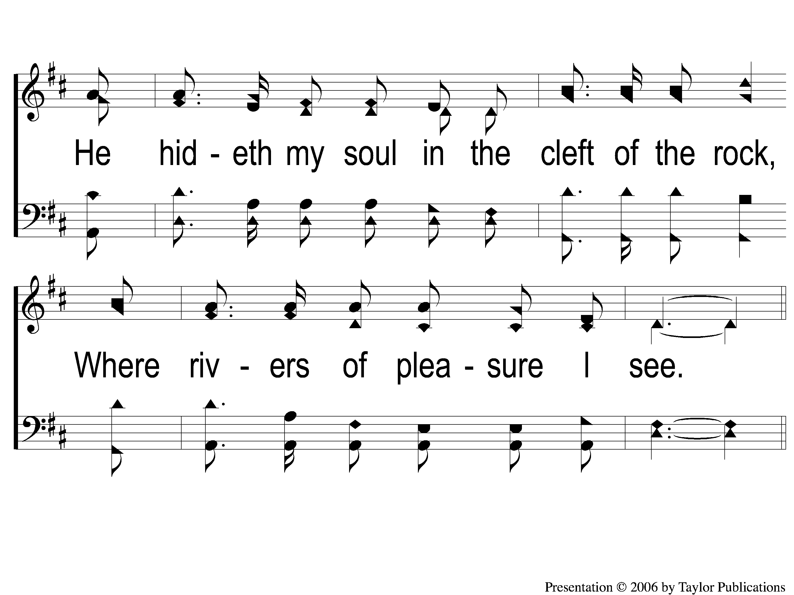
1-2 A Wonderful Savior(Crosby)
A Wonderful Savior
2

Slide 3
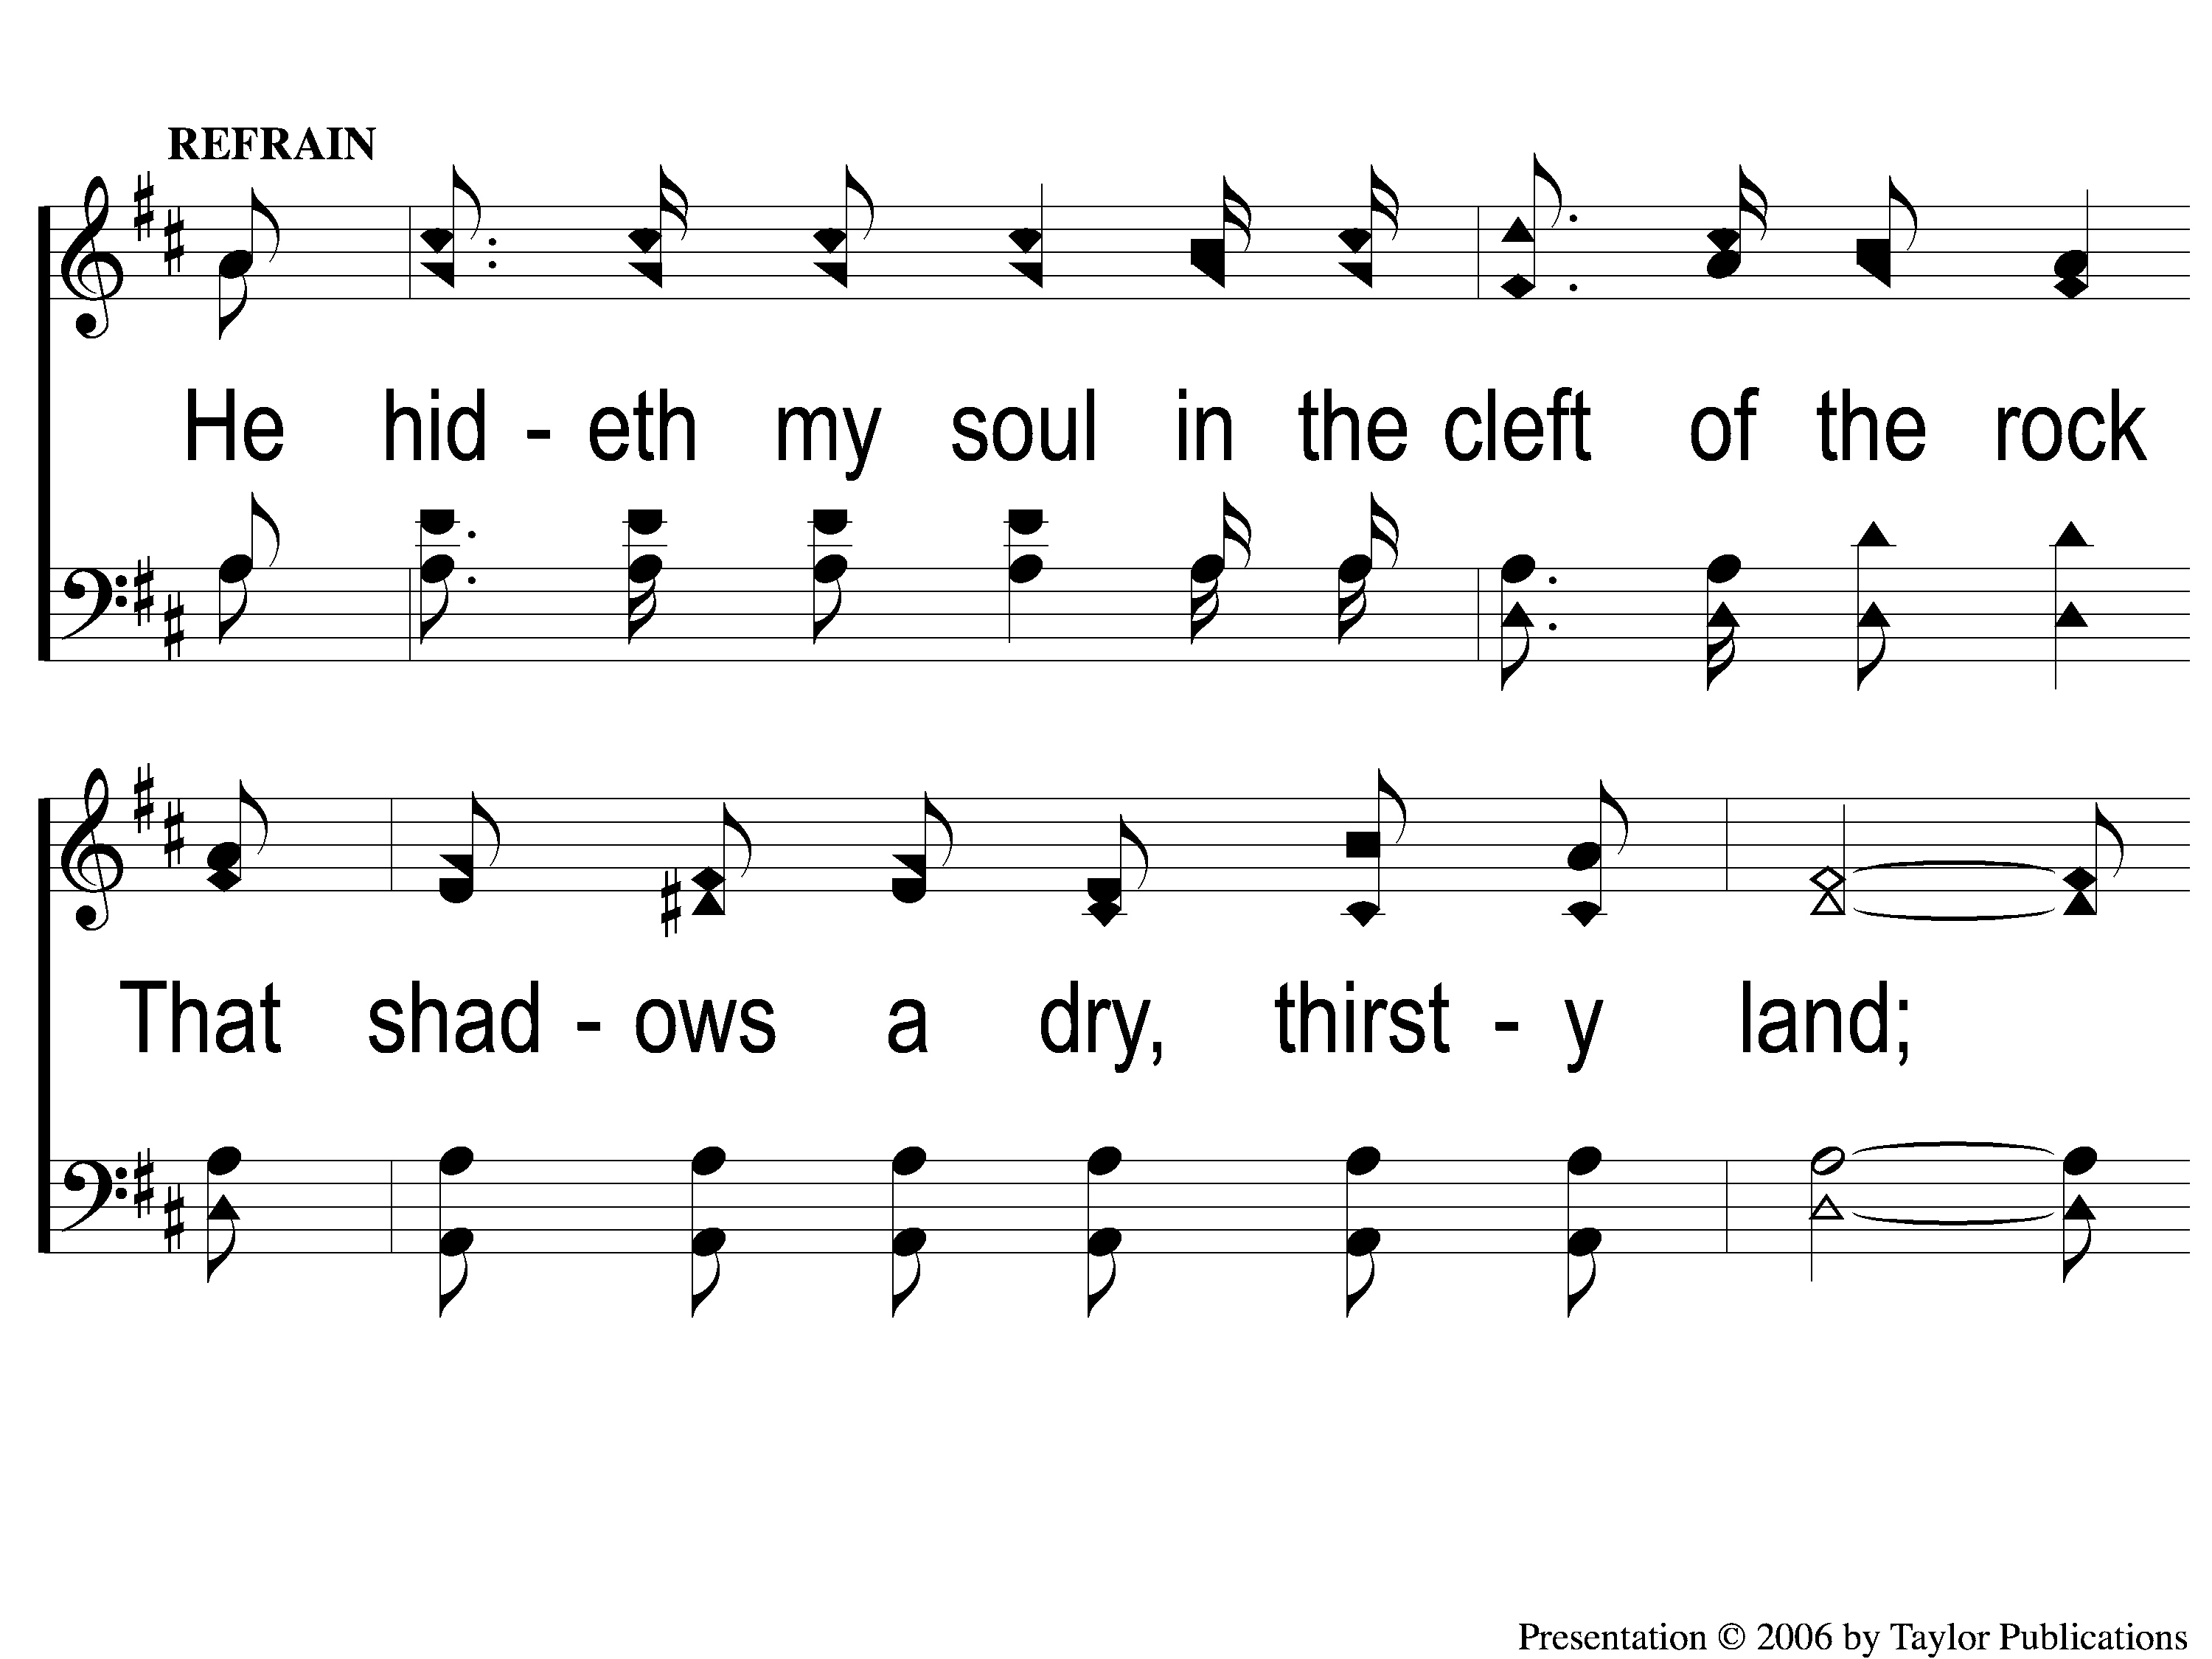
C-1 A Wonderful Savior(Crosby)
A Wonderful Savior
2

Slide 4
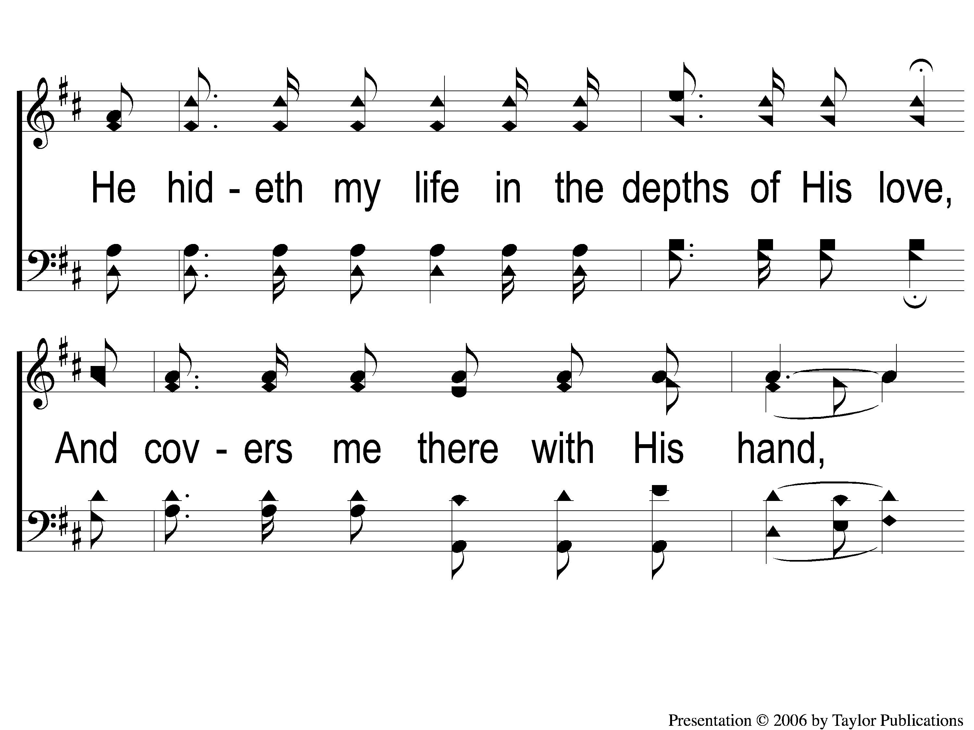
C-2 A Wonderful Savior(Crosby)
A Wonderful Savior
2

Slide 5
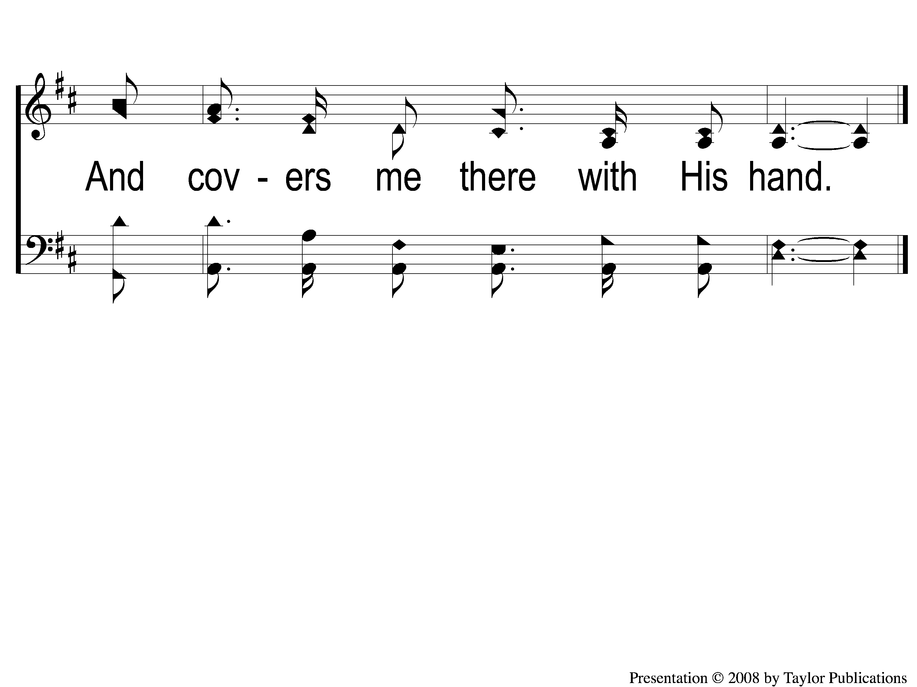
C-3 A Wonderful Savior(Crosby)
A Wonderful Savior
2

Slide 6
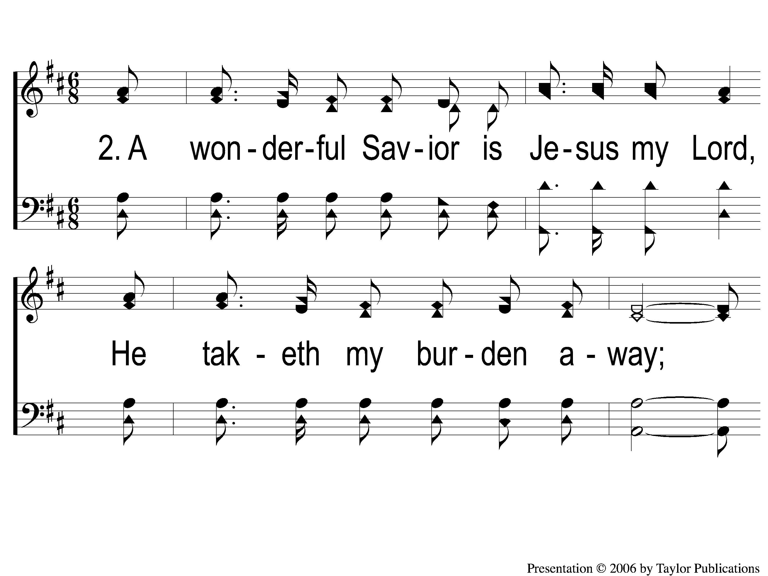
2-1 A Wonderful Savior(Crosby)
A Wonderful Savior
2

Slide 7
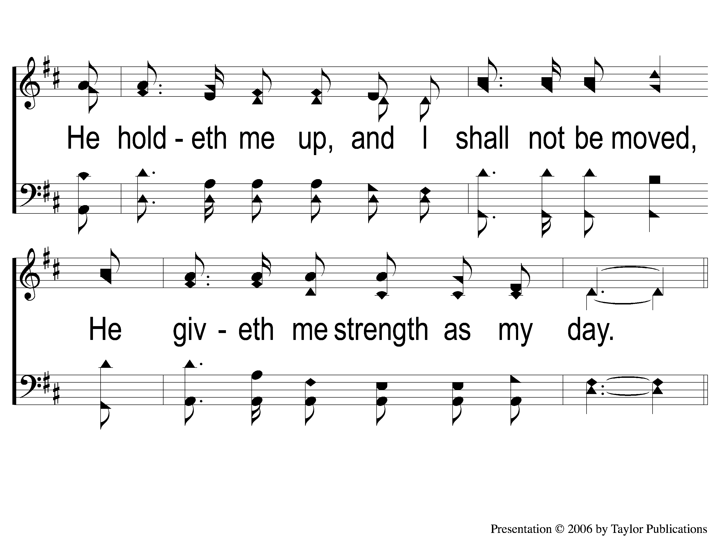
2-2 A Wonderful Savior(Crosby)
A Wonderful Savior
2

Slide 8
C-1 A Wonderful Savior(Crosby)
A Wonderful Savior
2

Slide 9
C-2 A Wonderful Savior(Crosby)
A Wonderful Savior
2

Slide 10
C-3 A Wonderful Savior(Crosby)
A Wonderful Savior
2

Slide 11
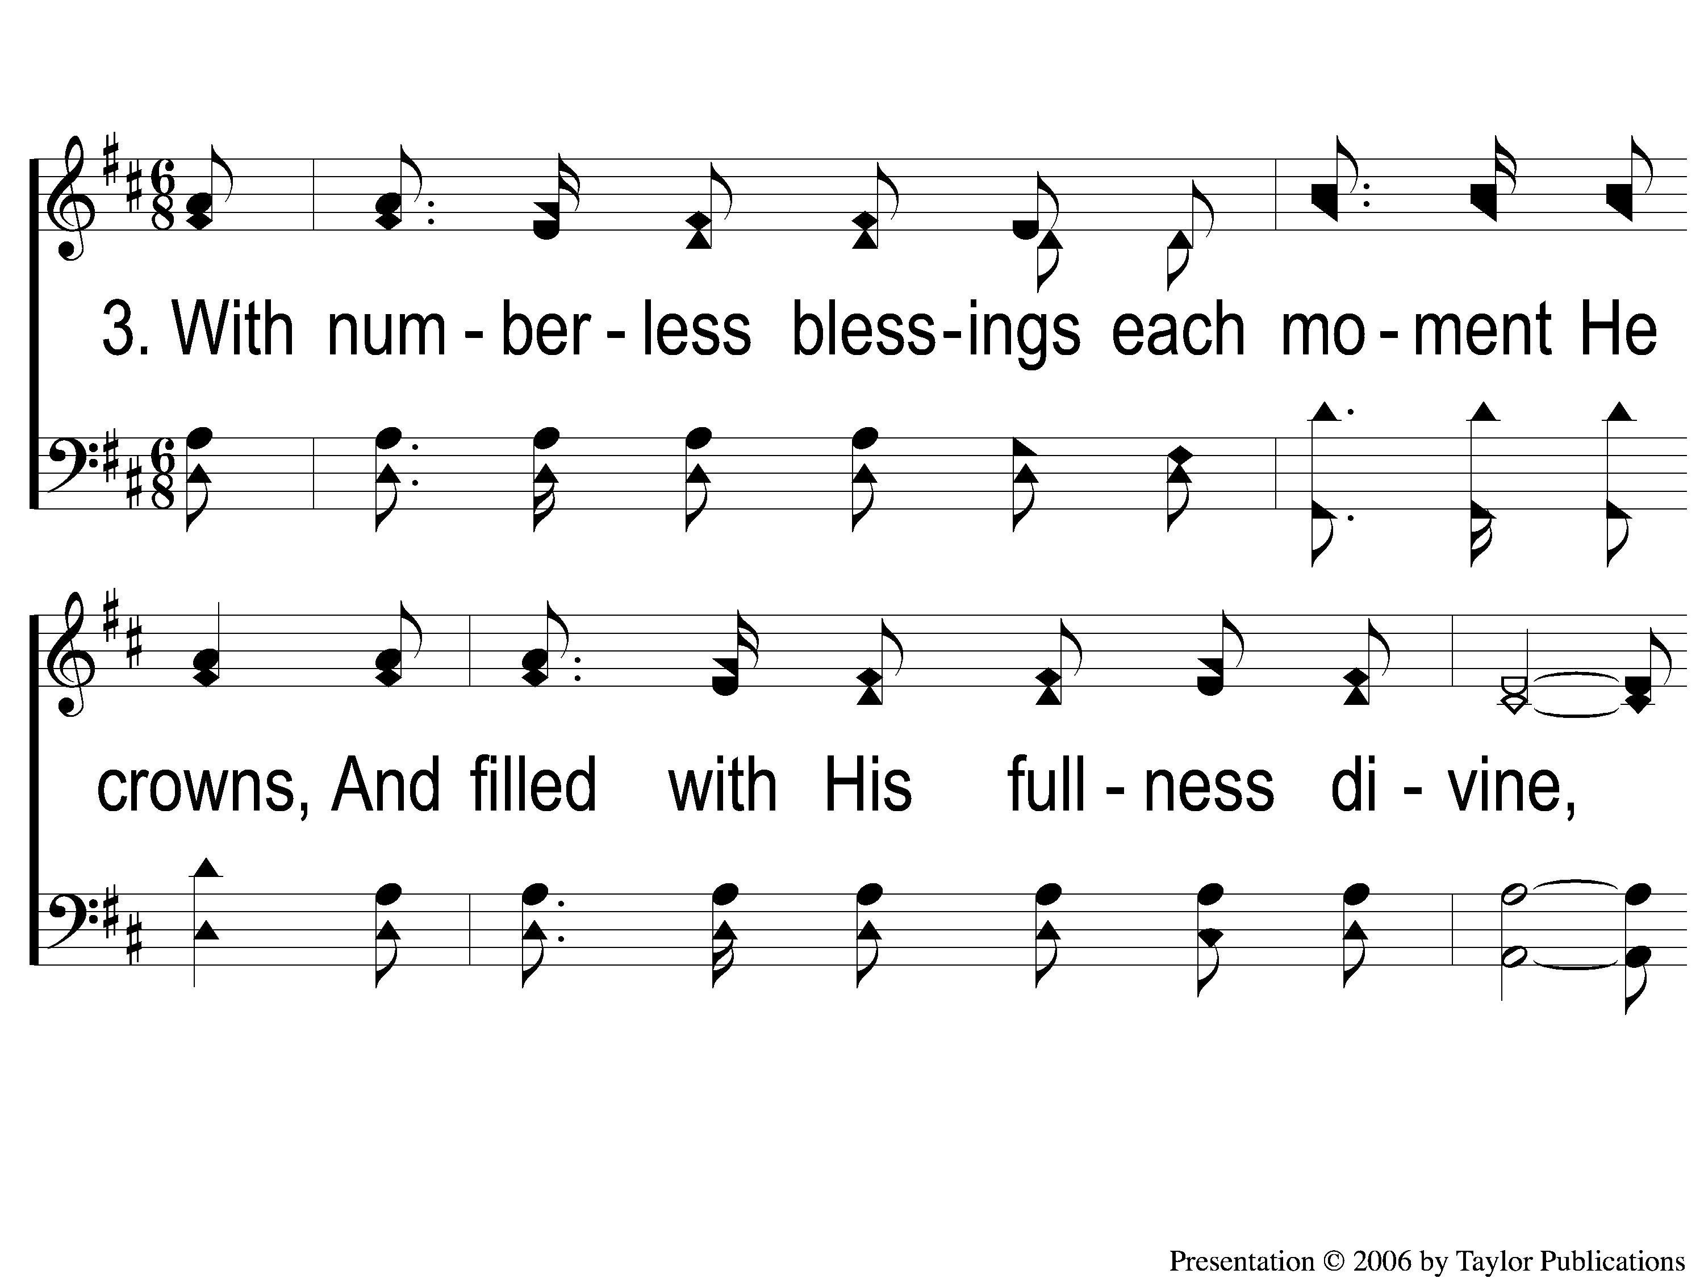
3-1 A Wonderful Savior(Crosby)
A Wonderful Savior
2

Slide 12
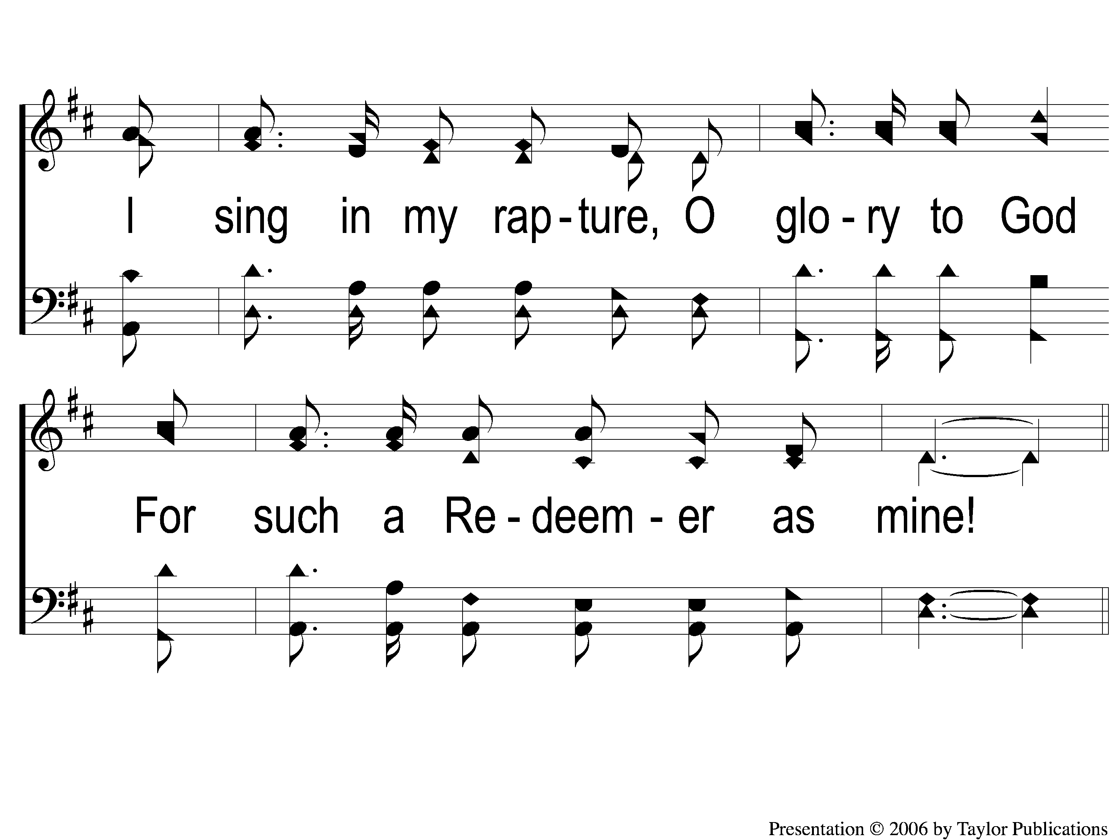
3-2 A Wonderful Savior(Crosby)
A Wonderful Savior
2

Slide 13
C-1 A Wonderful Savior(Crosby)
A Wonderful Savior
2

Slide 14
C-2 A Wonderful Savior(Crosby)
A Wonderful Savior
2

Slide 15
C-3 A Wonderful Savior(Crosby)
A Wonderful Savior
2

Slide 16
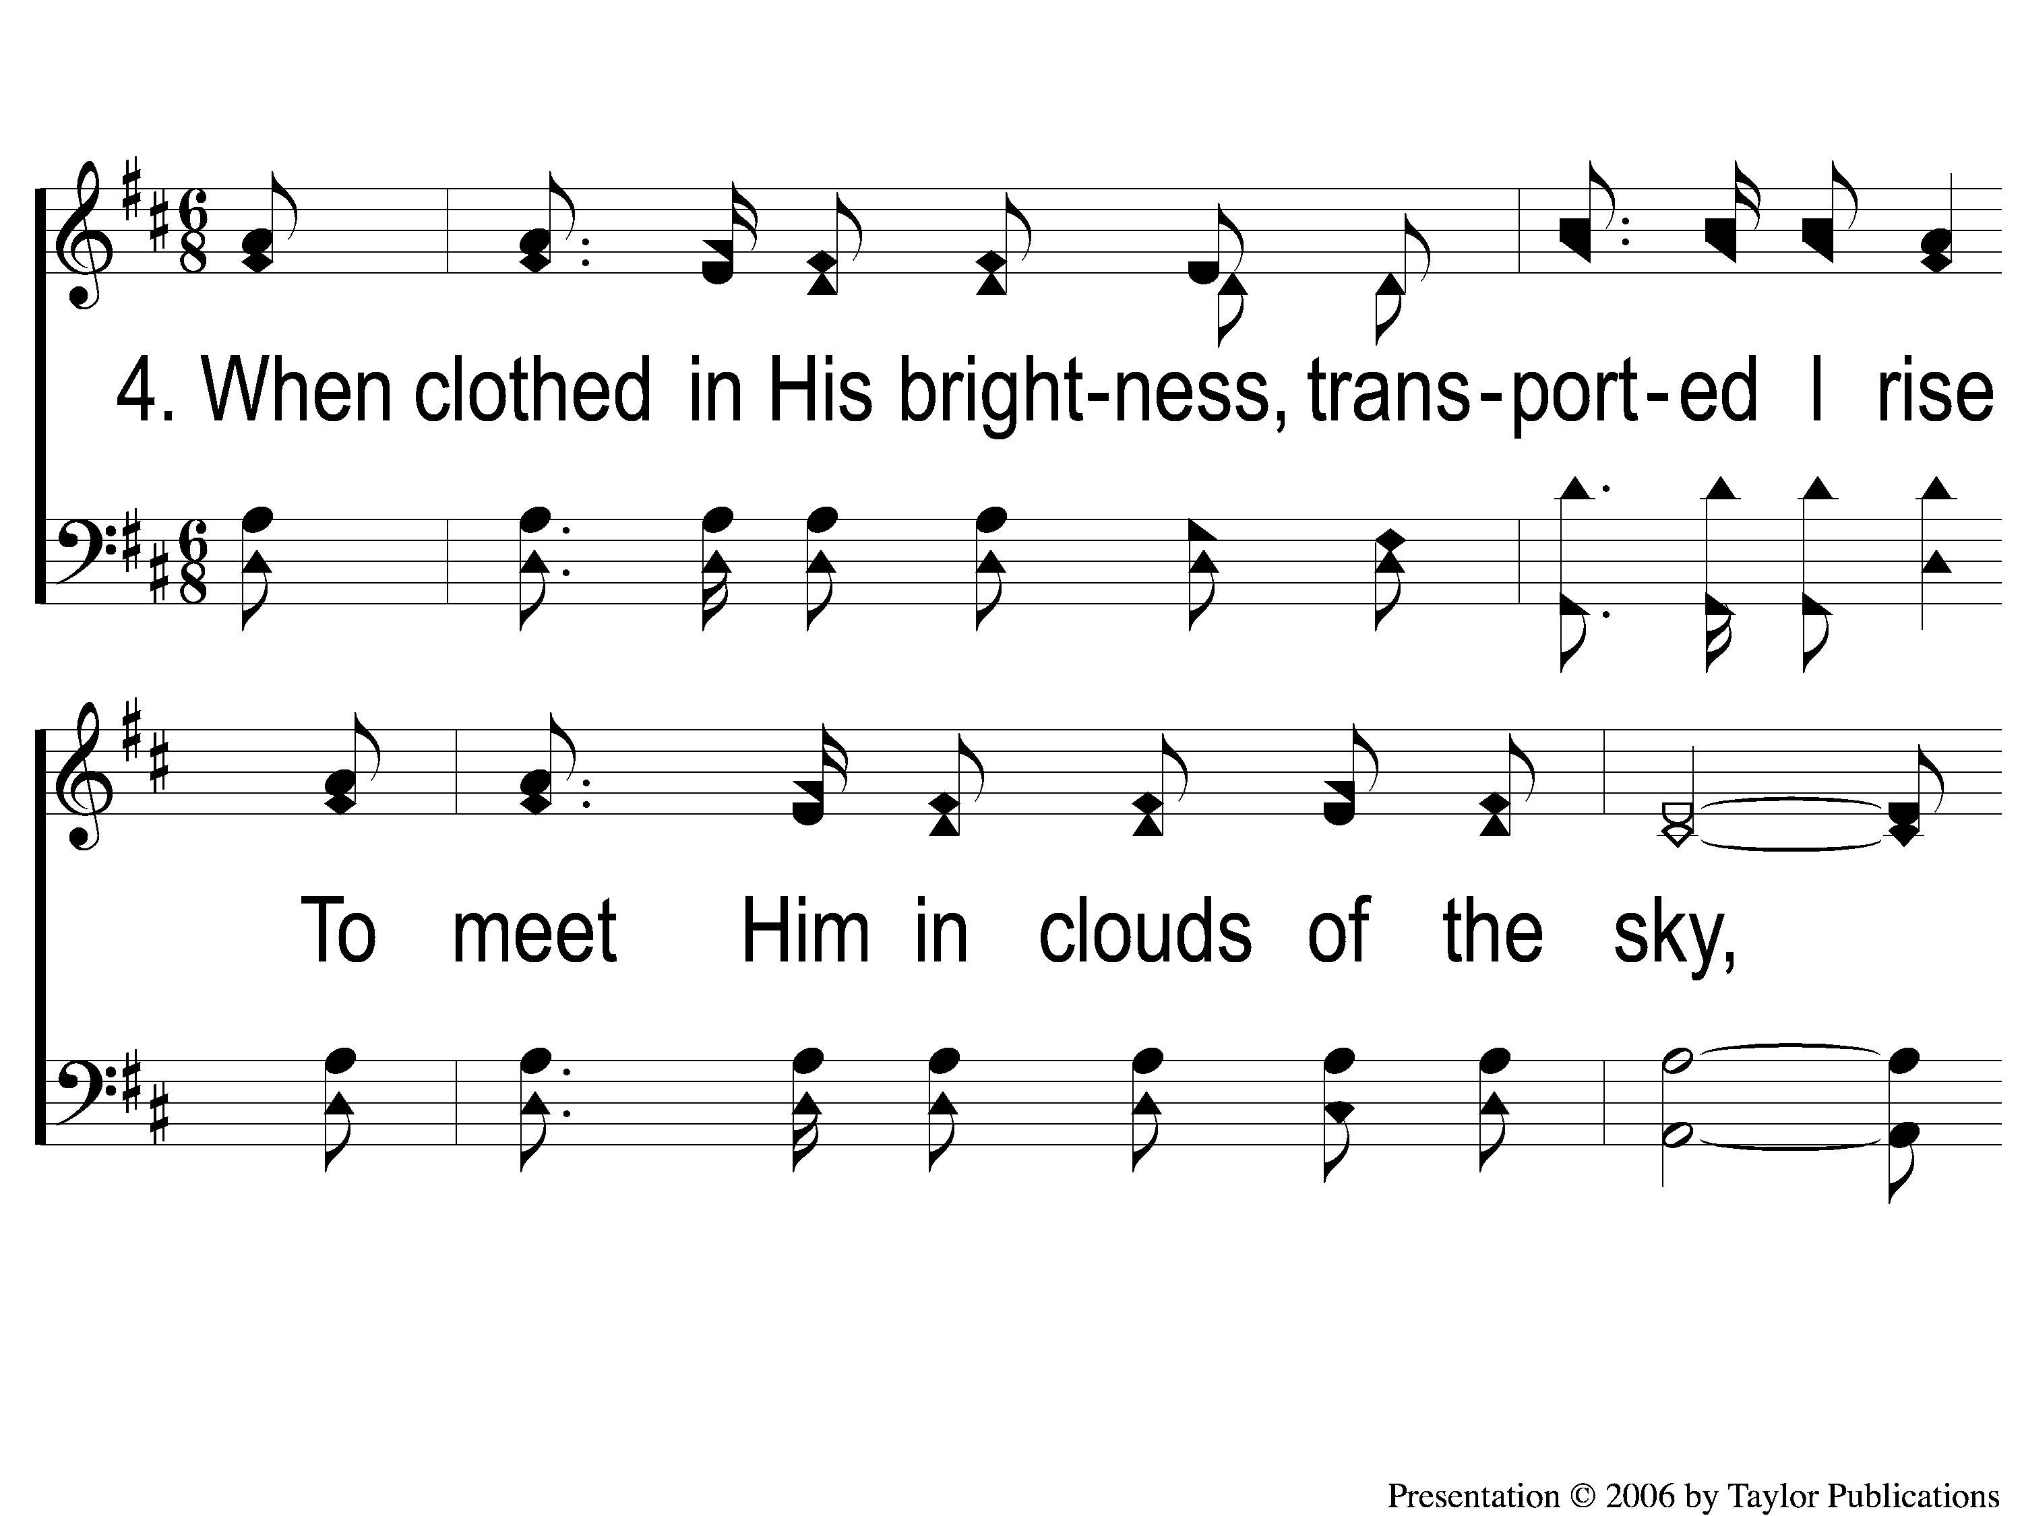
4-1 A Wonderful Savior(Crosby)
A Wonderful Savior
2

Slide 17
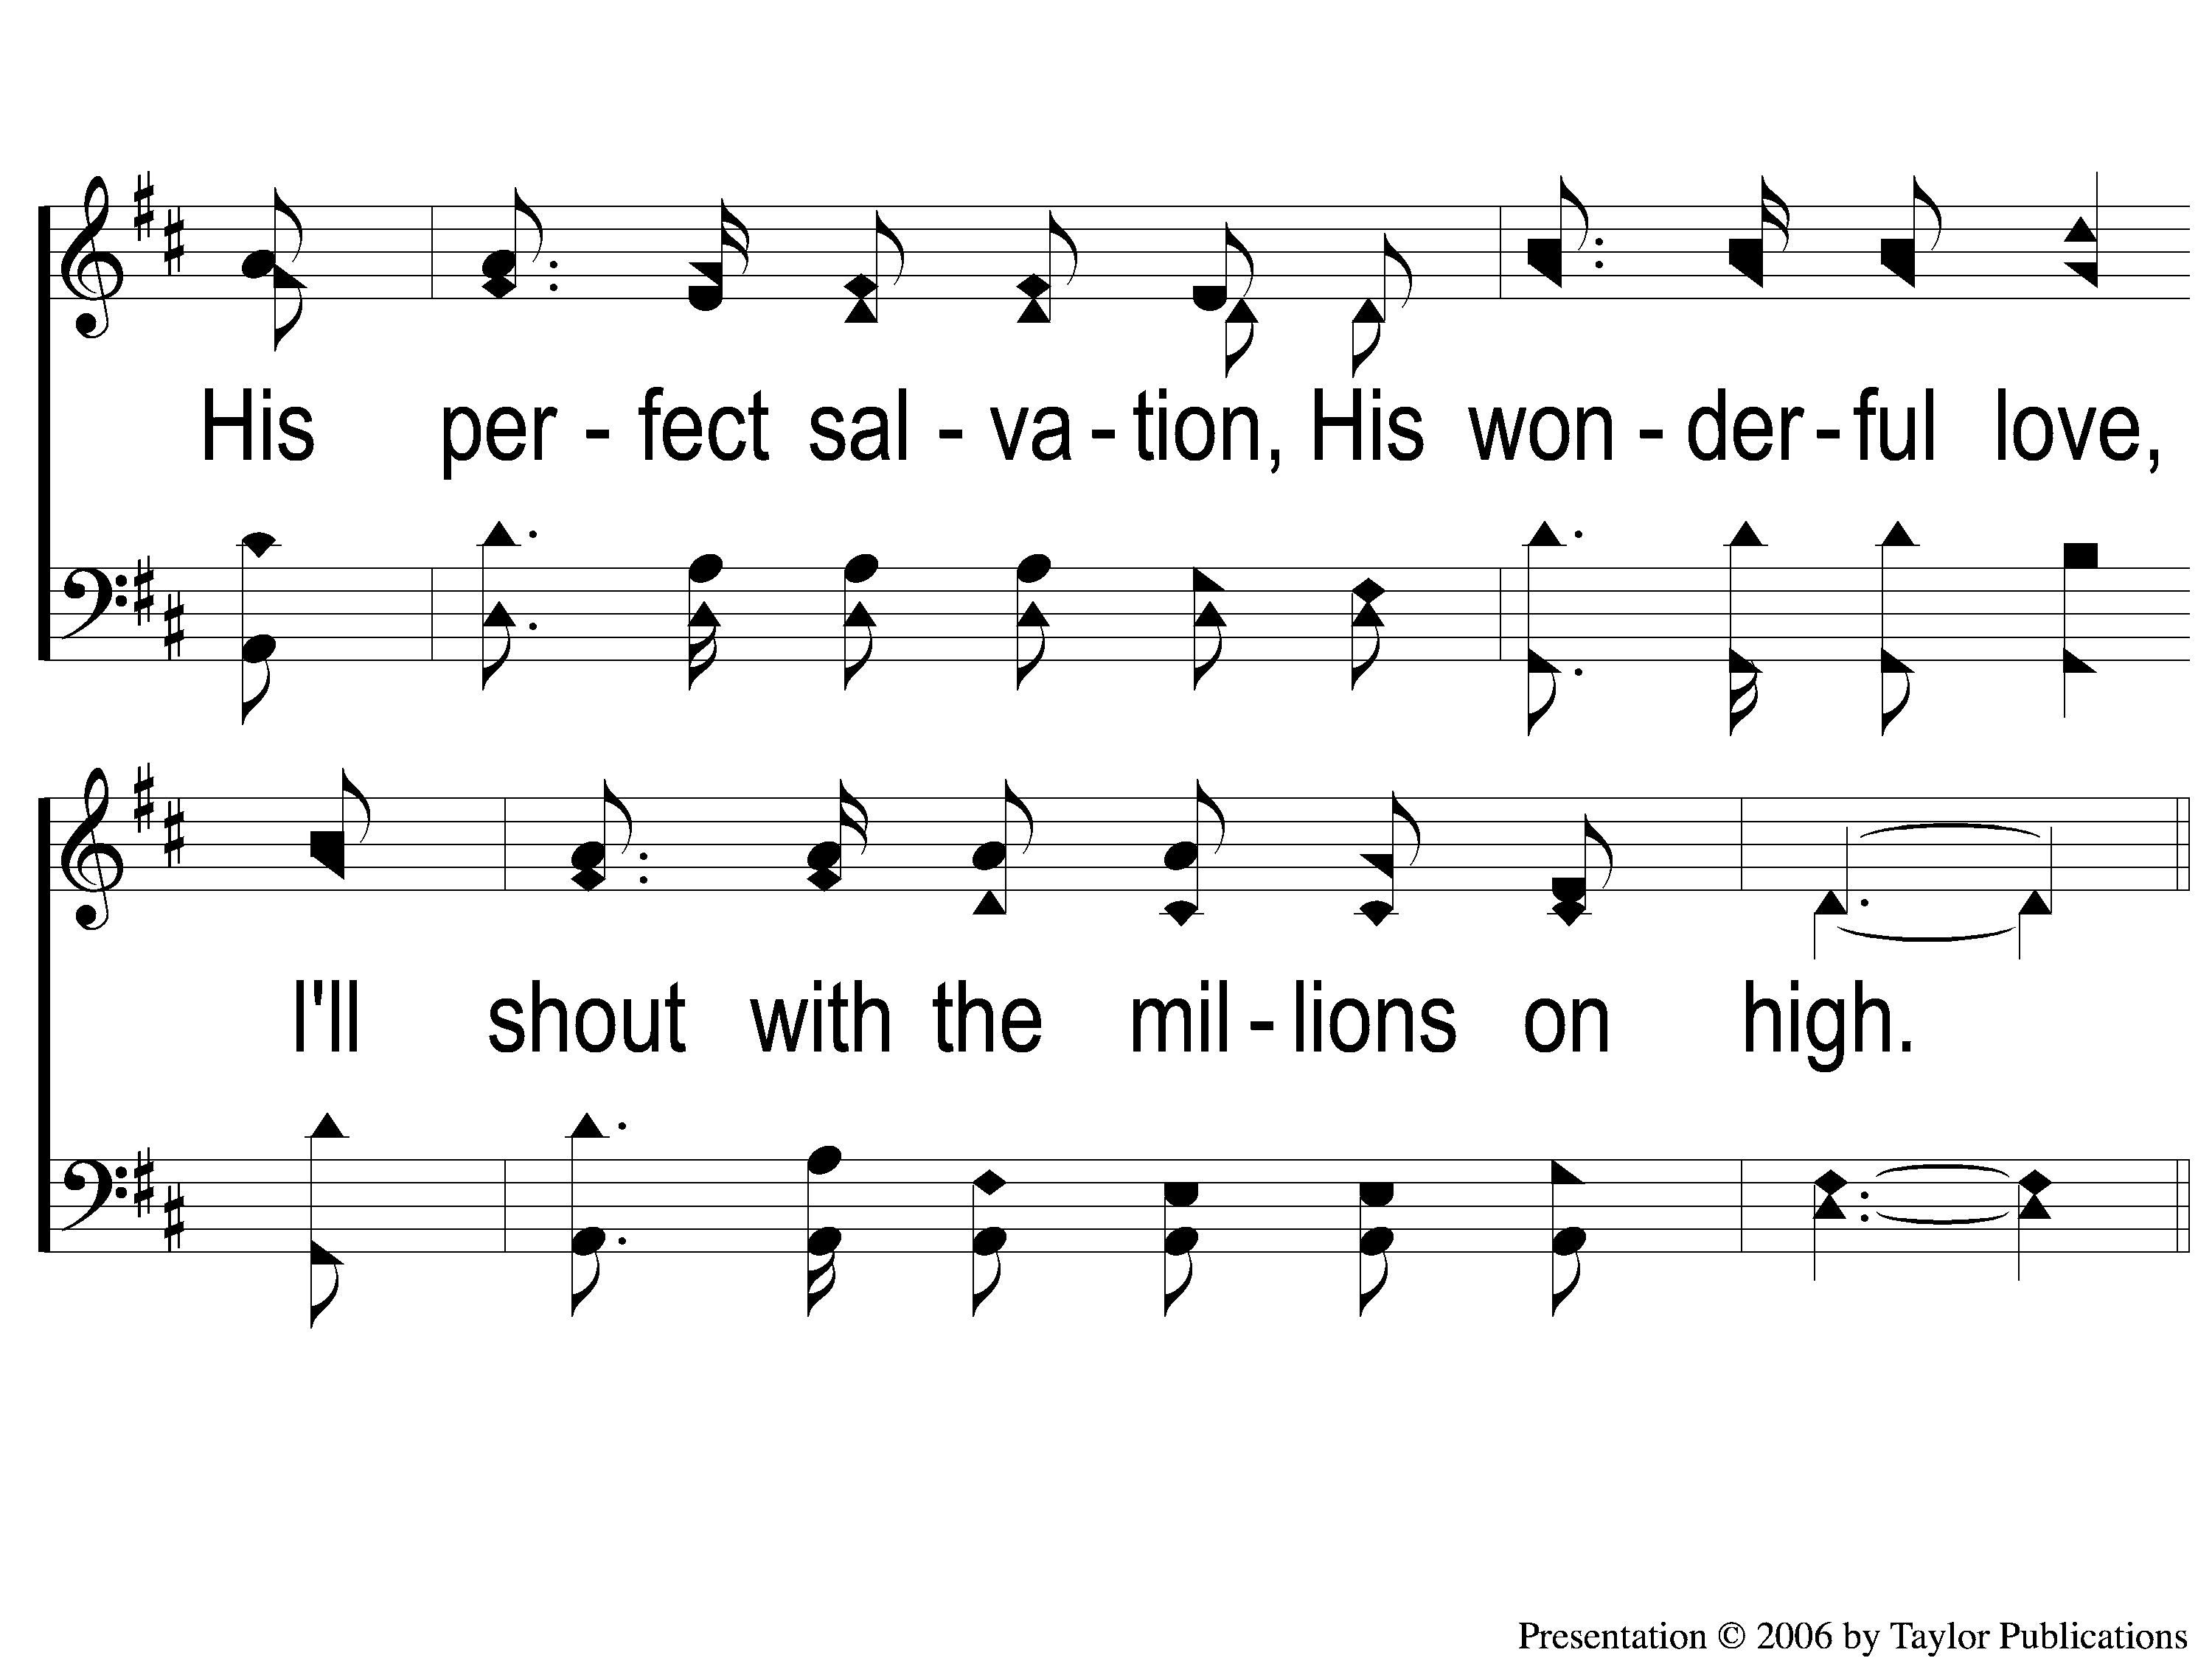
4-2 A Wonderful Savior(Crosby)
A Wonderful Savior
2

Slide 18
C-1 A Wonderful Savior(Crosby)
A Wonderful Savior
2

Slide 19
C-2 A Wonderful Savior(Crosby)
A Wonderful Savior
2

Slide 20
C-3 A Wonderful Savior(Crosby)
A Wonderful Savior
2

